Slide 1
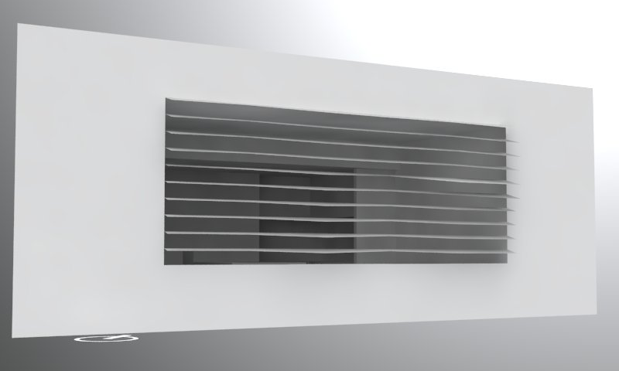
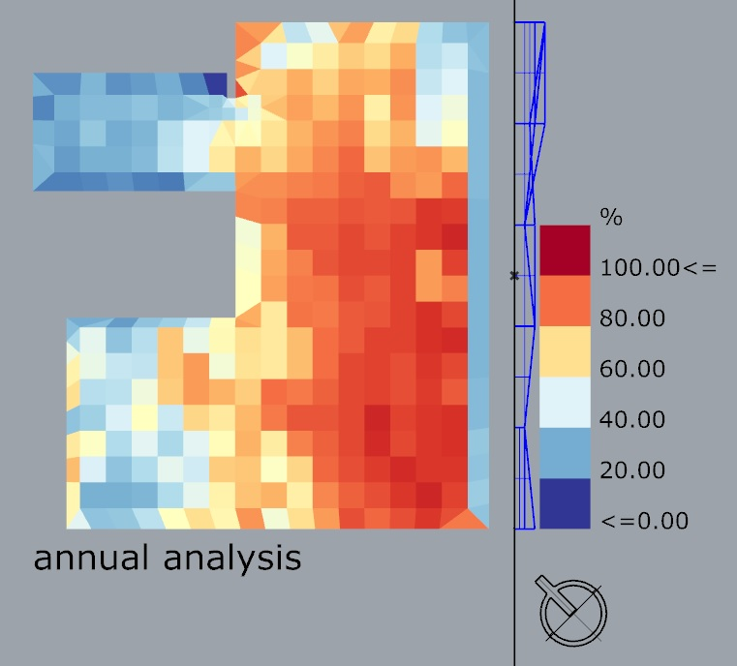
Daylight Design
Munazza Bhatti
Results
for Daylight
Autonomy
Design Intent:
Horizontal louvers manipulated to let more or less light in depending on sun orientation.

Slide 2
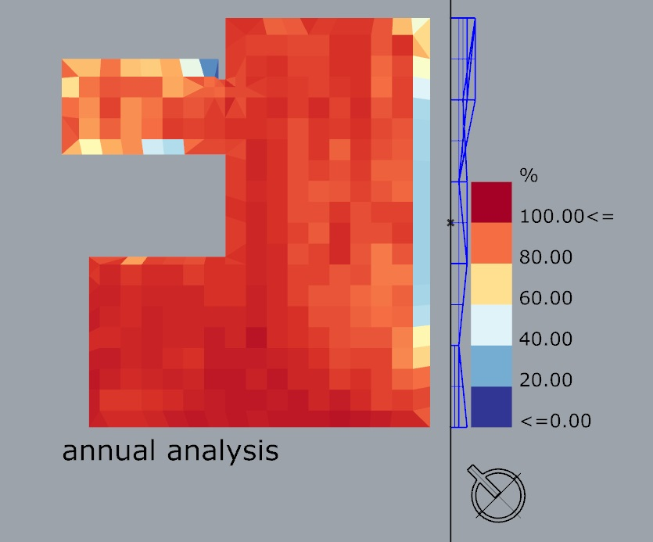
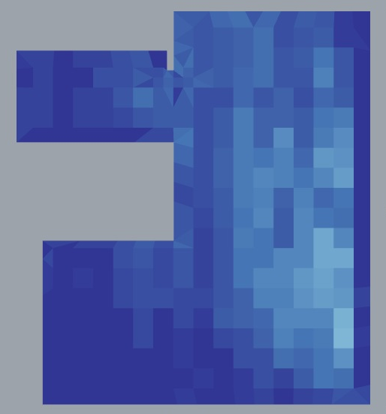
Useful Daylight Illuminance
Munazza Bhatti
Results for
Useful Daylight
Illuminance
100-2000 lux
Results for
Useful Daylight
Illuminance
> 2000 lux

Slide 3
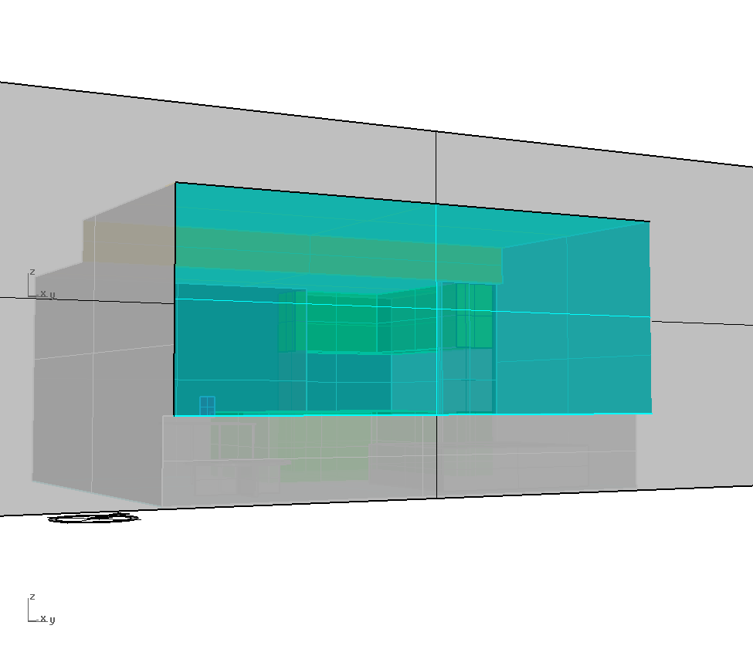
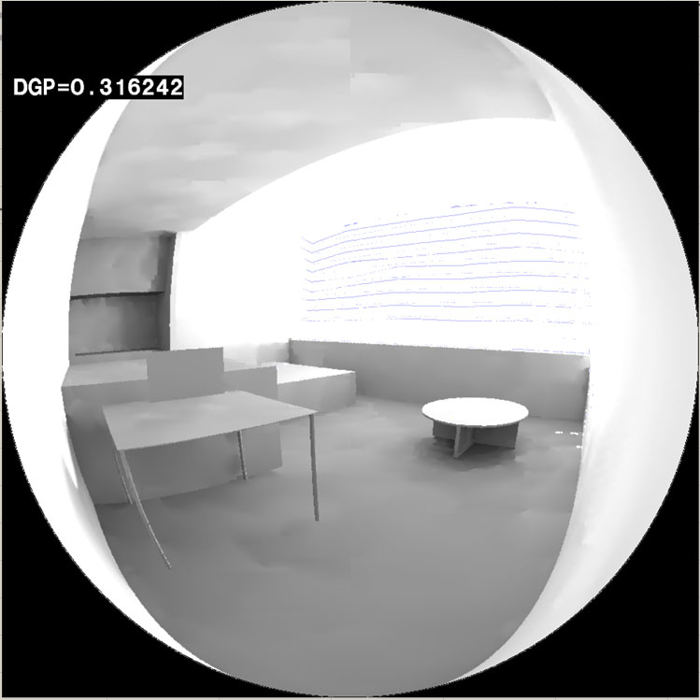
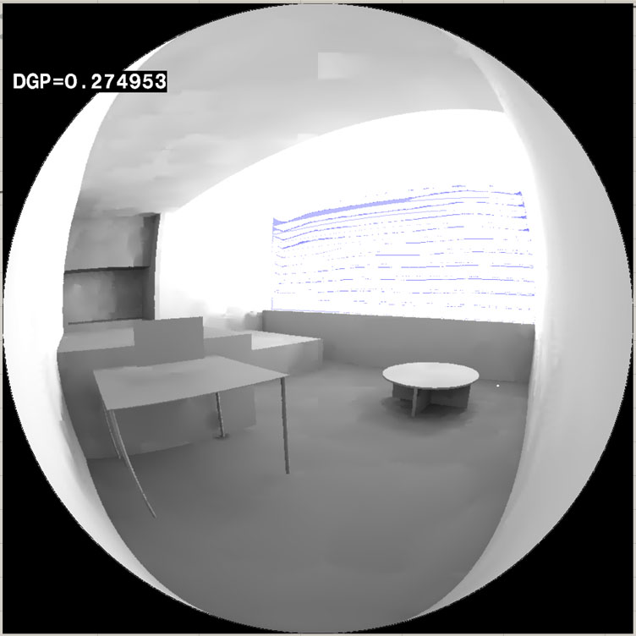
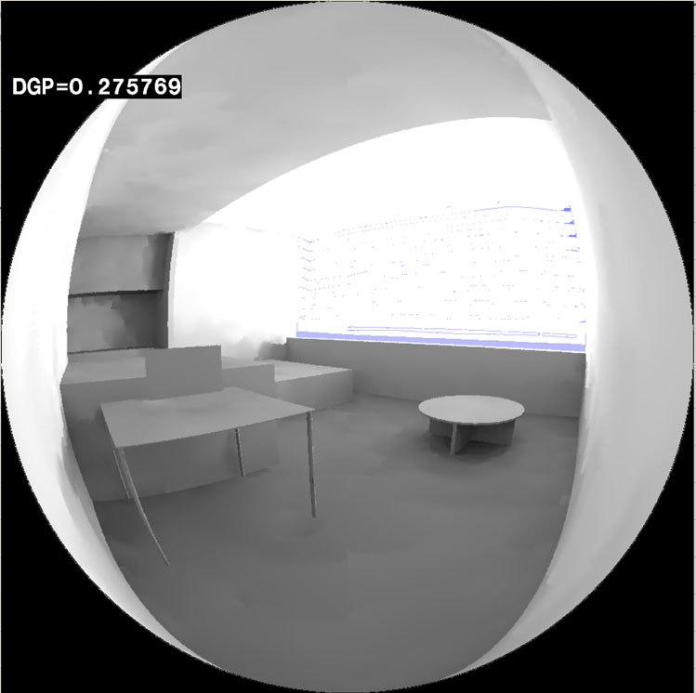
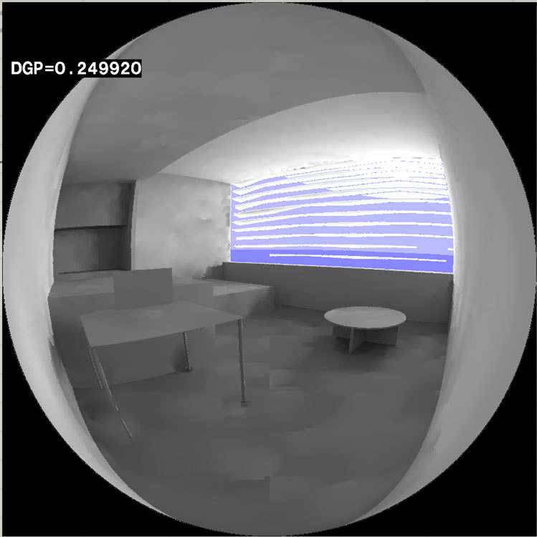
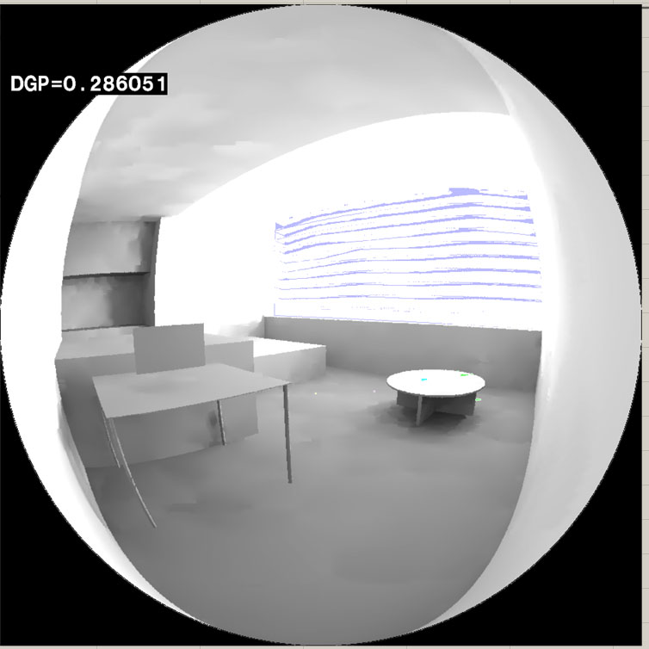
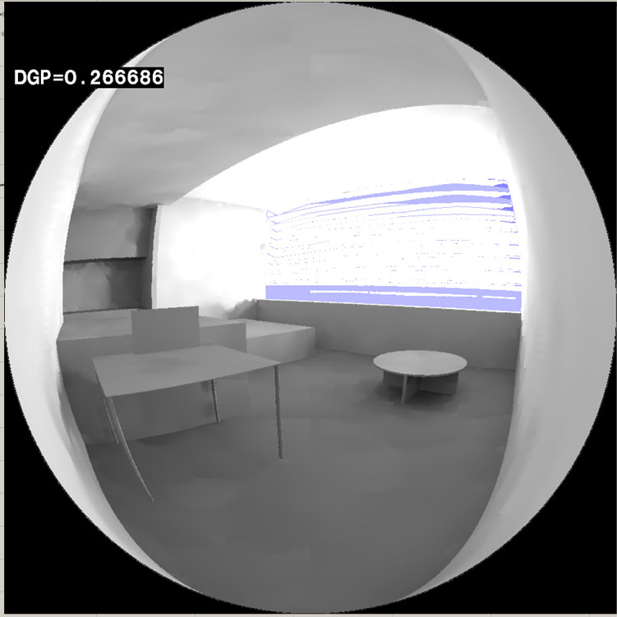
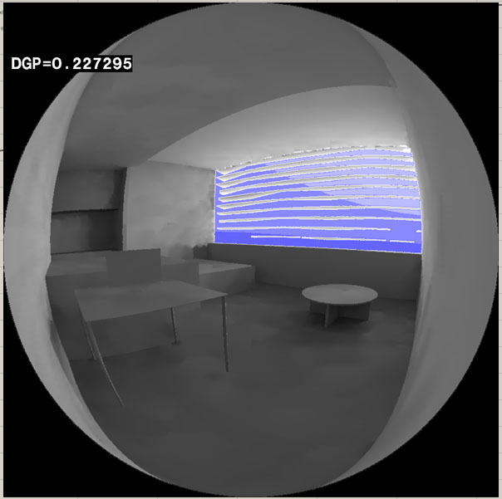
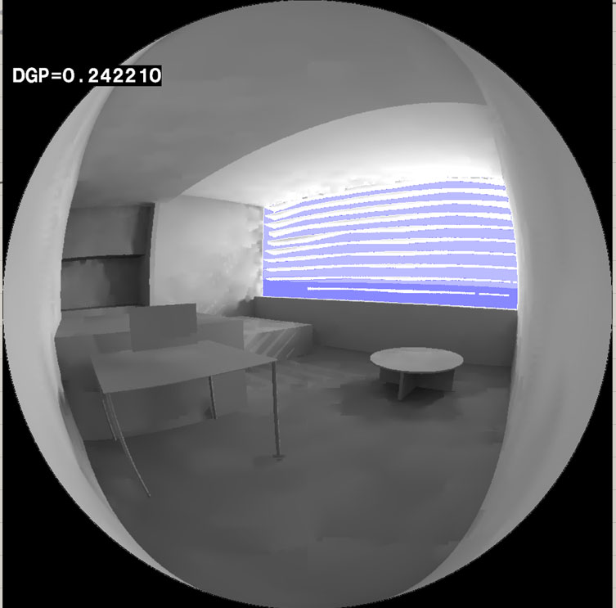
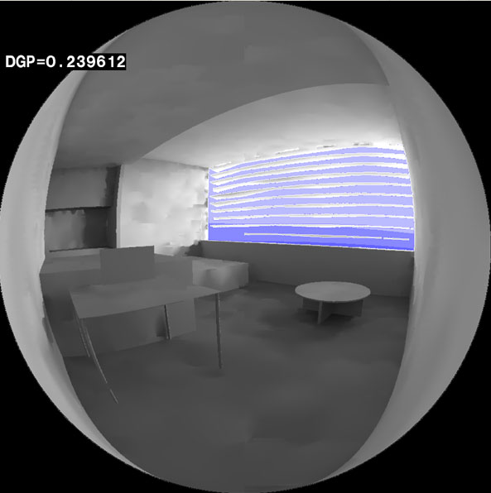
Glare Analysis
Munazza Bhatti
9 am
12 pm
15 pm
9 am
12 pm
15 pm
Glare Analysis
Before
Glare Analysis
Before
Glare Analysis
Before
Glare Analysis
After
Glare Analysis
After
Glare Analysis
After
21 Jun
DGP
DGP
DGP
DGP
DGP
DGP
Glare Analysis
Before
Glare Analysis
Before
Glare Analysis
Before
Glare Analysis
After
Glare Analysis
After
Glare Analysis
After
21 Mar
DGP
DGP
DGP
DGP
DGP
DGP
Glare Analysis
Before
Glare Analysis
Before
Glare Analysis
Before
Glare Analysis
After
Glare Analysis
After
Glare Analysis
After
21 Dec
DGP
DGP
DGP
DGP
DGP
DGP

